Slide 1

Classification of Animals
Julie Ann I. Guiritan
BEEd-P3

Slide 2
Classification of Animals
Scientists have divided the Animal Kingdom into two main groups:
VERTEBRATES
and
INVERTEBRATES

Slide 3
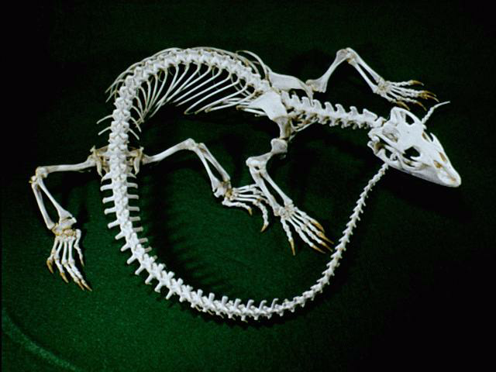
Vertebrates
Are Animals with backbones.
It is divided into five more groups:
Mammals
Birds
Reptiles
Amphibians
Fish

Slide 4
Vertebrates
Animals with a backbone.

Slide 5
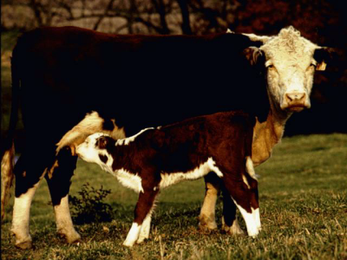
Mammals
Give birth to live young.
Feed their babies with their own milk.
Are more or less covered with hair.
Are warm-blooded.

Slide 6
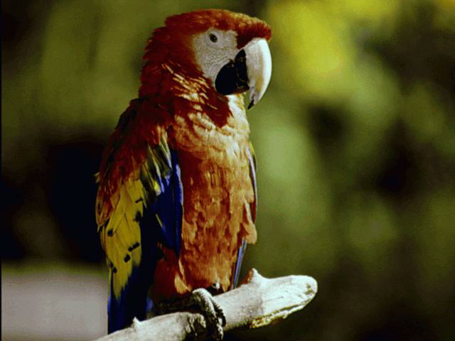
Birds
Have feathers.
Lay eggs.
Are warm-blooded.

Slide 7
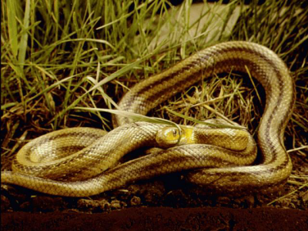
Reptiles
Are cold-blooded.
Lay eggs.
Have a dry skin covered with scales.

Slide 8
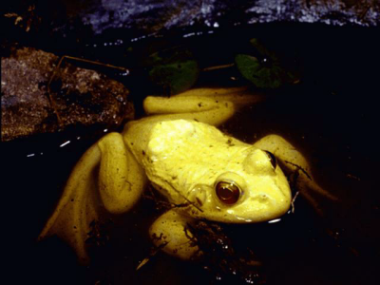
Amphibians
Are cold-blooded.
Lay eggs.
Have a smooth, moist skin.
Are able to live on land as well as in the water.

Slide 9
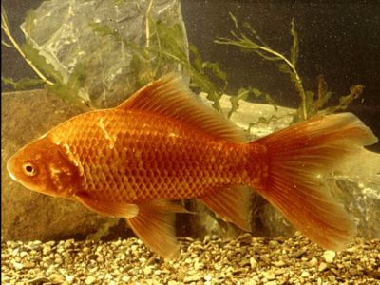
Fish
Are cold-blooded.
Lay eggs (but some do give birth to live young).
Have a moist skin covered in scales.
Breathe through gills.

Slide 10
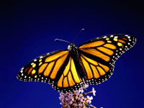
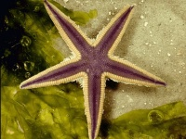
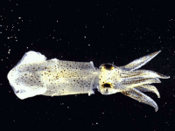
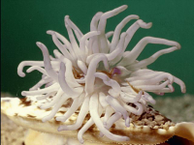
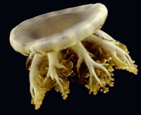
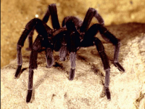
Invertebrates
Animals without a backbone.

Slide 11
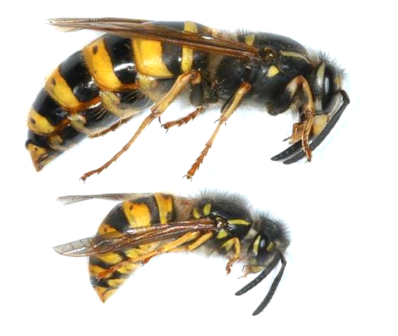

The SOCIAL INSECTS
Insects that share resources and produce cooperatively.

Slide 12
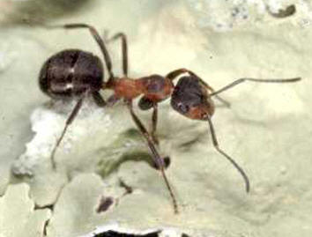
ANTS
Ants are probably the most highly developed social insects.

Slide 13
There are many different species of ants.
SLAVE MAKERS. They raid the nest of other species and carry away the larvae.
HARVESTER ANTS gather seeds and store them in their nests.
PARASOL ANTS cut pieces of leaves which they take to their nest and chew into a pulp.
WEAVER ANTS make their nest from leaves.
THE ARMY ANTS AND THE DRIVER ANTS The most dangerous ant colonies.

Slide 14
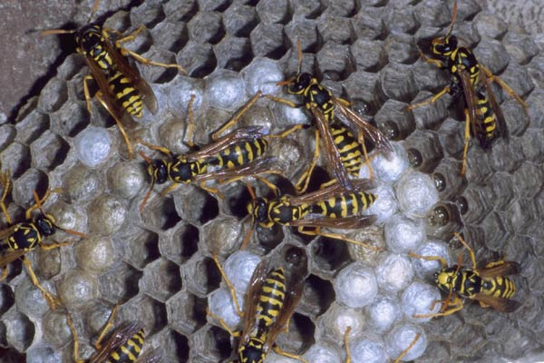
BEES
There are over 10000 different species of bees. Many species lead solitary lives while other species show a high level of social organisation. The honeybee colony lives in a hive which is often constructed in a hollow tree.

